Slide 1
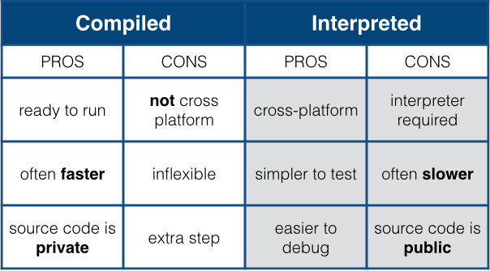
What is Python?
Interpreted (i.e. non-compiled), high-level programming language
Compiler translates to source code to machine code before executing script
Interpreter executes source code directly without prior compilation
Open-source (free) and community driven

Slide 2
Why use Python?
PROs:
Designed to be intuitive and easy to program in (without sacrificing power)
Open source, with a large community of packages and resources
One of the most commonly used programming languages in the world
“Tried and True” language that has been in development for decades
High quality visualizations
Runs on most operating systems and platforms
CONs:
Slower than “pure” (i.e. compiled) languages like C++
Smaller/specialized packages might not be well tested / maintained

Slide 3
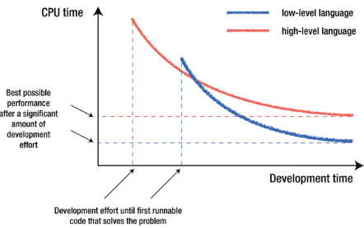
Which language is the best
No one language is better than all others.
The ‘best’ language depends on the task you are using it for and your personal preference.

Slide 4
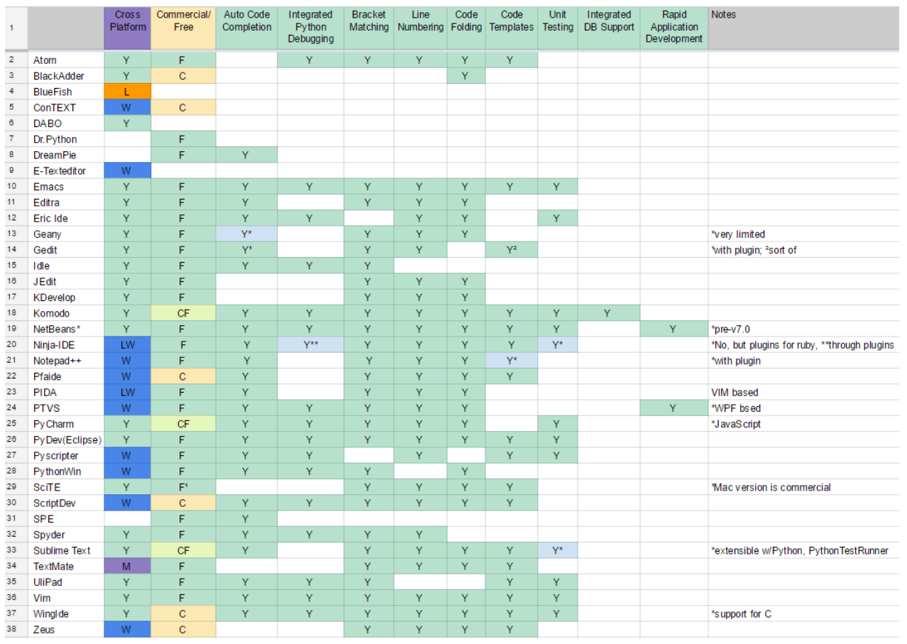
IDE

Slide 5
Types Basic Operations
Numbers
Integer
Float
Complex
Boolean
String
Operators (non-exhaustive list)
+ #addition
- #subtraction
* #multiplication
** # power
% # modulus
“in” # check if element is in container
Functions
(Custom) operations that take one or more pieces of data as arguments
len(‘world’)
Methods
Functions called directly off data using the “.” operator
‘Hello World”.split()

Slide 6
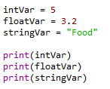

Variable types
A variable is assigned using the = operator; i.e:
Integer (int)
Float (float)
String (str)
Boolean (bool)
Complex (complex)
[…]
User defined (classes)
In:
Out:
The print() function is used to print something to the screen.
Create an integer, float, and string variable.
Print these to the screen.
Play around using different variable names, etc.

Slide 7

You can always check the type of a variable using the type() function.
In:
Out:
Check the type of one of your variables.

Slide 8


Variables can be cast to a different type.
In:
Out:

Slide 9
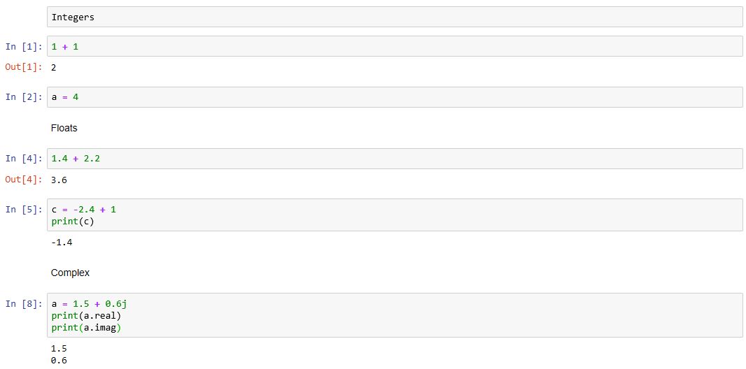
Examples: Numerical types

Slide 10
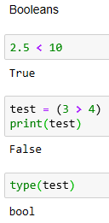
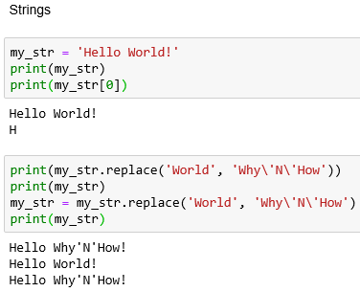
Examples: Booleans and Strings

Slide 11
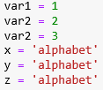
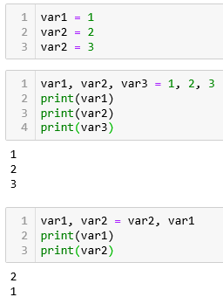
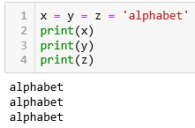
Variable Assignment

Slide 12


Arithmetic operators
The arithmetic operators:
Addition: +
Subtract: -
Multiplication: *
Division: /
Power: **
Write a couple of operations using the arithmetic operators, and print the results to the screen.
In:
Out:

Slide 13
A quick note on the increment operator shorthand
Python has a common idiom that is not necessary, but which is used frequently and is therefore worth noting:
x += 1
Is the same as:
x = x + 1
This also works for other operators:
x += y # adds y to the value of x
x *= y # multiplies x by the value y
x -= y # subtracts y from x
x /= y # divides x by y

Slide 14
Boolean operators
Boolean operators are useful when making conditional statements, we will cover these in-depth later.
and
or
not

Slide 15
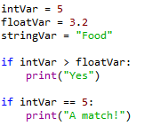

Comparison operators
Write a couple of operations using comparison operators; i.e.
Greater than: >
Lesser than: <
Greater than or equal to: >=
Lesser than or equal to: <=
Is equal to: ==
In:
Out:

Slide 16
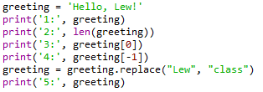



Working with strings
In:
Out:
Create a string variable.
Work out the length of the string.

Slide 17
Data Containers (aka Objects)
Lists (mutable set of objects)
var = ['one', 1, 1.0]
Tuples (immutable set of objects)
var = ('one', 1, 1.0)
Dictionaries (hashing arbitrary key names to values)
var = {'one': 1, 'two': 2, 1: 'one', 2: 'two’}
Etc.
Each of the above has its own set of methods

Slide 18
When to use one container over another
Lists
If you need to append/insert/remove data from a collection of (arbitrary typed) data
Tuples
If you are defining a constant set of values (and then not change it), iterating over a tuple is faster than iterating over a list
Dictionaries
If you need a key:value pairing structure for your dataset (i.e. searching for a persons name (a key) will provide their phone number (a value))

Slide 19
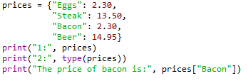

Dictionaries
Dictionaries are lists of key-valued pairs.
In:
Out:

Slide 20




Indexing
Indexing in Python is 0-based, meaning that the first element in a string, list, array, etc, has an index of 0. The second element then has an index of 1, and so on.
In:
Out:
You can cycle backwards through a list, string, array, etc, by placing a minus symbol in front of the index location.
In:
Out:

Slide 21



In:
Out:
In:
Out:
Create a string that is 10 characters in length.
Print the second character to the screen.
Print the third to last character to the screen.
Print all characters after the fourth character.
Print characters 2-8.

Slide 22


Tuples
Tuples are containers that are immutable; i.e. their contents cannot be altered once created.
In:
Out:
In:
Out:

Slide 23


Lists
Lists are essentially containers of arbitrary type.
They are probably the container that you will use most frequently.
The elements of a list can be of different types.
The difference between tuples and lists is in performance; it is much faster to ‘grab’ an element stored in a tuple, but lists are much more versatile.
Note that lists are denoted by [] and not the () used by tuples.
In:
Out:
Create a list and populate it with some elements.

Slide 24


Adding elements to a list
Lists are mutable; i.e. their contents can be changed. This can be done in a number of ways.
With the use of an index to replace a current element with a new one.
In:
Out:
Replace the second element in your string with the integer 2.

Slide 25


You can use the insert() function in order to add an element to a list at a specific indexed location, without overwriting any of the original elements.
In:
Out:
Use insert() to put the integer 3 after the 2 that you just added to your string.

Slide 26


You can add an element to the end of a list using the append() function.
In:
Out:
Use append() to add the string “end” as the last element in your list.

Slide 27


Removing elements from a list
You can remove an element from a list based upon the element value.
Remember: If there is more than one element with this value, only the first occurrence will be removed.
In:
Out:

Slide 28


It is better practice to remove elements by their index using the del function.
In:
Out:
Use del to remove the 3 that you added to the list earlier.

Slide 29
For loops
The for loop is used to iterate over elements in a sequence, and is often used when you have a piece of code that you want to repeat a number of times.
For loops essentially say: “For all elements in a sequence, do something”

Slide 30
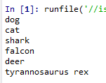
An example
We have a list of species:
The command underneath the list then cycles through each entry in the species list and prints the animal’s name to the screen. Note: The i is quite arbitrary. You could just as easily replace it with ‘animal’, ‘t’, or anything else.

Slide 31
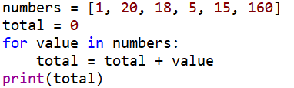

Another example
We can also use for loops for operations other than printing to a screen. For example:
Using the list you made a moment ago, use a for loop to print each element of the list to the screen in turn.

Slide 32






The range() function
The range() function generates a list of numbers, which is generally used to iterate over within for loops.
The range() function has two sets of parameters to follow:
range(stop)
stop: Number of integers
(whole numbers) to generate,
starting from zero. i.e:
range([start], stop[, step])
start: Starting number of the sequence.
stop: Generate numbers up to, but not including this number.
step: Difference between each number in the sequence
i.e.:
Note:
All parameters must be integers.
Parameters can be positive or negative.
The range() function (and Python in general) is 0-index based, meaning list indexes start at 0, not 1. eg. The syntax to access the first element of a list is mylist[0]. Therefore the last integer generated by range() is up to, but not including, stop.

Slide 33
Create an empty list.
Use the range() and append() functions to add the integers 1-20 to the empty list.
Print the list to the screen, what do you have?
Output:

Slide 34
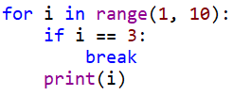

The break() function
To terminate a loop, you can use the break() function.
The break() statement breaks out of the innermost enclosing for or while loop.

Slide 35

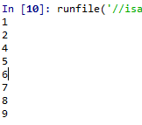
The continue () function
The continue() statement is used to tell Python to skip the rest of the statements in the current loop block, and then to continue to the next iteration of the loop.

Slide 36
While loops
The while loop tells the computer to do something as long as a specific condition is met.
It essentially says:
“while this is true, do this.”
When working with while loops, its important to remember the nature of various operators.
While loops use the break() and continue() functions in the same way as a for loop does.

Slide 37
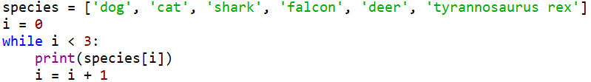

An example

Slide 38

A bad example

Slide 39



Create a variable and set it to zero.
Write a while loop that states that, while the variable is less than 250, add 1 to the variable and print the variable to the screen.
In:
Out:
Replace the < with <=, what happens?

Slide 40
For loop vs. while loop
You will use for loops more often than while loops.
The for loop is the natural choice for cycling through a list, characters in a string, etc; basically, anything of determinate size.
The while loop is the natural choice if you are cycling through something, such as a sequence of numbers, an indeterminate number of times until some condition is met.

Slide 41

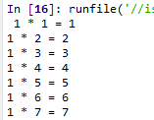
Nested loops
In some situations, you may want a loop within a loop; this is known as a nested loop.
What will the code on the right produce?
Recreate this code and run it, what do you get?
In:
Out:

Slide 42


Conditionals
There are three main conditional statements in Python; if, else, elif.
We have already used if when looking at while loops.
In:
Out:
In:
Out:

Slide 43
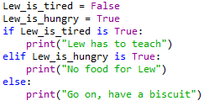
An example of elif
In:
Out:

Slide 44
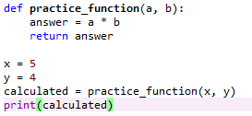

Functions
A function is a block of code which only runs when it is called.
They are really useful if you have operations that need to be done repeatedly; i.e. calculations.
The function must be defined before it is called. In other words, the block of code that makes up the function must come before the block of code that makes use of the function.
In:
Out:

Slide 45

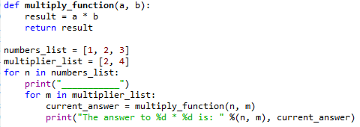
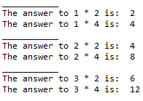
Create a function that takes two inputs, multiplies them, and then returns the result. It should look some like: def function_name(a, b): do something return something
Create two different lists of integers.
Using your function, write a nested for loop that cycles through each entries in the first list and multiples it by each of the entries in the second list, and prints the result to the screen.
In:
Out:

Slide 46
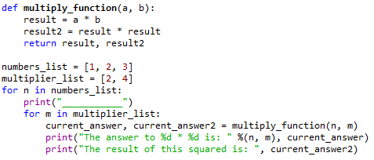
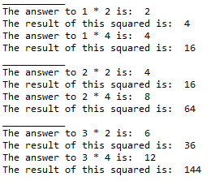
Multiple returns
You can have a function return multiple outputs.
In:
Out:

Slide 47
Reading and writing to files in Python: The file object
File handling in Python can easily be done with the built-in object file.
The file object provides all of the basic functions necessary in order to manipulate files.
Open up notepad or notepad++. Write some text and save the file to a location and with a name you’ll remember.

Slide 48
The open() function
Before you can work with a file, you first have to open it using Python’s in-built open() function.
The open() function takes two arguments; the name of the file that you wish to use and the mode for which we would like to open the file
By default, the open() function opens a file in ‘read mode’; this is what the ‘r’ above signifies.
There are a number of different file opening modes. The most common are: ‘r’= read, ‘w’=write, ‘r+’=both reading and writing, ‘a’=appending.
Use the open() function to read the file in.

Slide 49
The close() function
Likewise, once you’re done working with a file, you can close it with the close() function.
Using this function will free up any system resources that are being used up by having the file open.

Slide 50
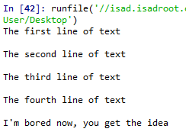

Reading in a file and printing to screen example
Using what you have now learned about for loops, it is possible to open a file for reading and then print each line in the file to the screen using a for loop.
Use a for loop and the variable name that you assigned the open file to in order to print each of the lines in your file to the screen.
In:
Out:

Slide 51
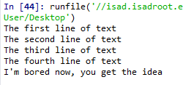


The read() function
However, you don’t need to use any loops to access file contents. Python has three in-built file reading commands:
1. <file>.read() = Returns the entire contents of the file as a single string:
2. <file>.readline() = Returns one line at a time:
3. <file>.readlines() = Returns a list of lines:

Slide 52


The write() function
Likewise, there are two similar in-built functions for getting Python to write to a file:
1. <file>.write() = Writes a specified sequence of characters to a file:
2. <file>.writelines() = Writes a list of strings to a file:
Important: Using the write() or writelines() function will overwrite anything contained within a file, if a file of the same name already exists in the working directory.

Slide 53
Practice – writing to a file in Python
Part 1:
Open the file you created in the last practice and ready it for being written to.
Write a string to that file. Note: this will overwrite the old contents.
Remember to close the file once you are done.
Part 2:
Create a list of strings.
Use the open() function to create a new .txt file and write your list of strings to this file.
Remember to close the file once you are done.

Slide 54
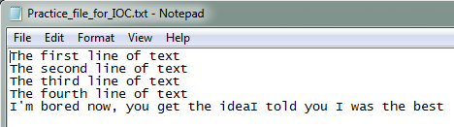

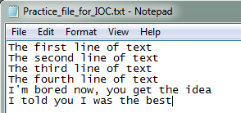
The append() function
If you do not want to overwrite a file’s contents, you can use the append() function.
To append to an existing file, simply put ‘a’ instead of ‘r’ or ‘w’ in the open() when opening a file.

Slide 55
Practice – appending to a file in Python
Open the text file you created in part two of the writing to a file practice, and ready it for appending.
Define a string object.
Appending this new string object to the file.
Remember to close the file once you are done.

Slide 56

A word on import
To use a package in your code, you must first make it accessible.
This is one of the features of Python that make it so popular.
In:
There are pre-built Python packages for pretty much everything.
In:

